Slide 1
Multiple Linear Regression

Slide 2
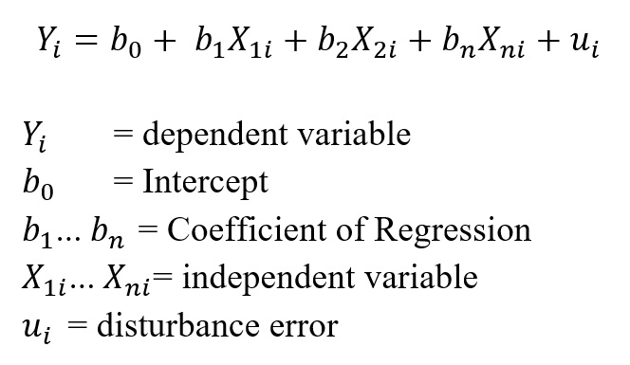

Multiple Independent Features

Slide 3
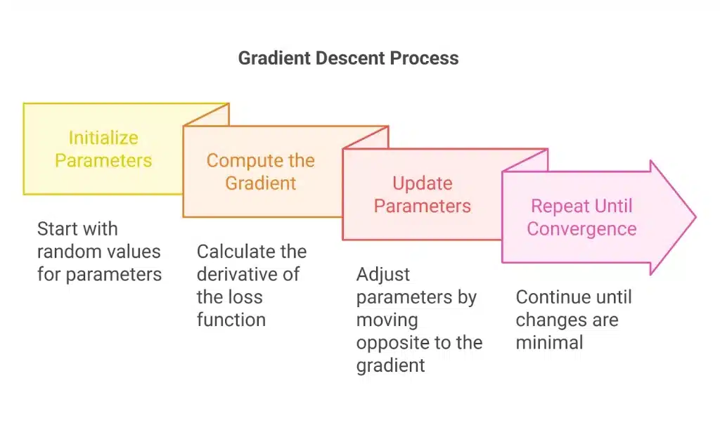
Gradient Descent Algorithm

Slide 4
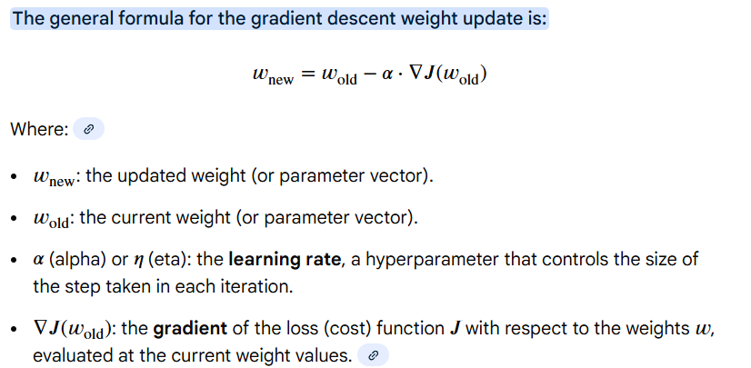




Weights/Coefficients/Slope updation

Slide 5
Here are the steps in detail:
Define a Loss Function: Choose a function (e.g., Mean Squared Error) that quantifies the difference between your model's predictions and the actual target values.
Initialize Parameters: Assign random starting values to your model's weights (w) and biases (b).
Make Predictions: Pass your input data through the model using the current weights and biases to get predicted outputs.
Calculate the Error/Loss: Use the loss function to determine how wrong your predictions were.
Compute the Gradient: Calculate the partial derivative (gradient) of the loss function with respect to each parameter (weight and bias). This tells you the direction and steepness of the error's slope.
Update Parameters: Adjust the weights and biases by subtracting the gradient multiplied by the learning rate (α) from the current parameter value.
new_parameter = old_parameter - (learning_rate * gradient)
Repeat: Go back to Step 3 and repeat the process (predict, calculate loss, find gradient, update) until the loss stops decreasing significantly or a set number of iterations is reached, indicating convergence.
This process effectively "walks" the parameters downhill on the loss function's landscape, finding the minimum point where the error is smallest.

Slide 6
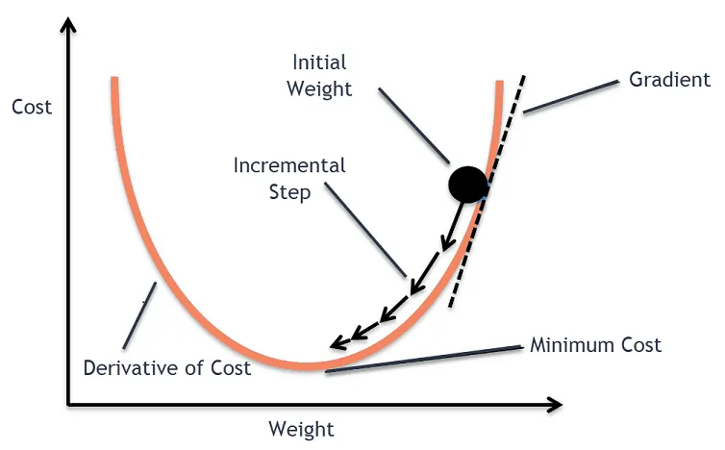


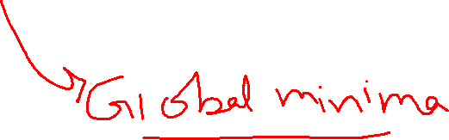




Gradient Descent

